Slide 1
Tailwind CSS -A utility-first CSS
A utility-first CSS framework for
rapidly building custom designs.

Slide 2
01
INTRODUCTION

Slide 3
What is Tailwind Css
According to the official website, Tailwind CSS is a utility-first CSS framework for rapidly building custom designs. Some developers don't like it because it makes the HTML/JSX or any markup look busier. But I found it cool as I don't have to write any single CSS for a website it doesn't matter if it's a big as E-commerce or just a simple landing page.
With Tailwind CSS you have full control over your component not like Bootstrap. You will not get ready-made styles classes you have to create your own

Slide 4
02
CSS Frameworks vs
Tailwind CSS
1... 2.. 3.. Let’s Fight

Slide 5

Bootstrap
Power of Bootstrap
Bootstrap is a free and open-source CSS framework
directed at responsive, mobile-first front-end web
development. It contains CSS- and JavaScript-based
design templates for typography, forms, buttons,
navigation, and other interface components.

Slide 6

Tailwind CSS
Power of Tailwind CSS
Tailwind is a utility-first CSS framework for rapidly
building custom user interfaces. The beauty about this
thing called tailwind is it doesn't impose design
specification or how your site should look like, you
simply bring tiny components together to construct a
user interface that are unique and is also Open Source

Slide 7
Stars on Github
Bootstrap
141K
Tailwind CSS
24.1K
Foundation
21.4K

Slide 8
03
BENEFITS
Let’s discuss power of Tailwind CSS

Slide 9



BENEFITS
Customization
It comes with a default
configuration, but it’s
straightforward to override
the default configuration with
a tailwind.config.js file in
your project.
No Naming Things
Tailwind provide utility
classes that can be used 99%
of the time. The only time
you’ll have to name things is
when you extract a
component,
No Context Switching
One of the reasons Tailwind
is so much faster to use is
you barely ever have to
switch contexts.
HTML -CSS

Slide 10



BENEFITS
Development Speed
Because you don’t need to
name things, you don’t have
to switch context as much,
and you’re not fighting the
framework to make
customizations, prototyping
and implementing custom
designs is really fast using
Tailwind.
Responsive Everywhere
All of Tailwind’s utilities are
generated with responsive
versions that you can use to
make your site look different
on mobile, tablet, and
desktop screen sizes. On top
of that, it offers the @screen
and @responsive directives
Small Size (after Purge CSS)
Initially, when you see the
CSS file outputted by
Tailwind, you might be
shocked at the large file size
(477.6kb unminified).
Thankfully, there are a few
things that can help reduce
the file size tremendously

Slide 11
04
INSTALLATION
Installing TailwindCSS

Slide 12
Using Tailwind via CDN
Install Tailwind via npm

Slide 13
Using Tailwind via CDN
Before using the CDN build, please note that many of the features that make Tailwind CSS great are not available without incorporating Tailwind into your build process.
You can't customize Tailwind's default theme.
You can't use any directives like @apply, @variants, etc.
You can't enable additional variants like group-focus.
You can't install third-party plugins.
You can't tree-shake unused styles.
To pull in Tailwind for quick demos or just giving the framework a spin, grab the latest default configuration build via CDN:

Slide 14
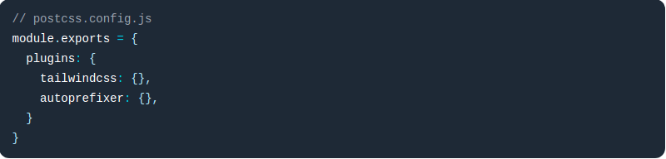
Install Tailwind via npm
REQUIRES
Tailwind CSS requires Node.js 12.13.0 or higher.
autoprefixer.
PostCSS.
Add Tailwind as a PostCSS plugin

Slide 15
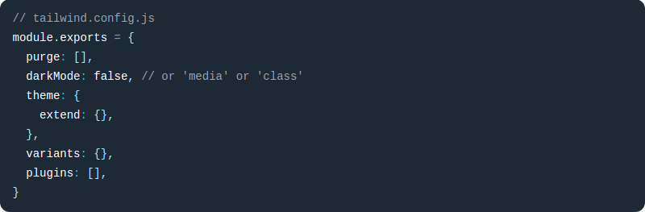
Create your configuration file
If you’d like to customize your Tailwind installation, generate a config file for your project using the Tailwind CLI utility included when you install the tailwindcss npm package:

Slide 16
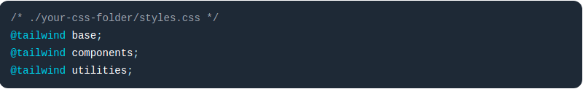
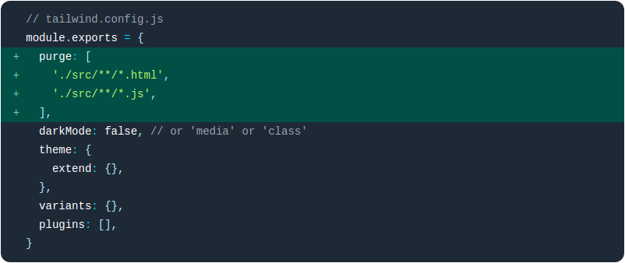
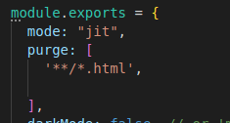
Include Tailwind in your CSS
Create a CSS file if you don’t already have one, and use the @tailwind directive to inject Tailwind’s base, components, and utilities styles:
Building your CSS

Slide 17
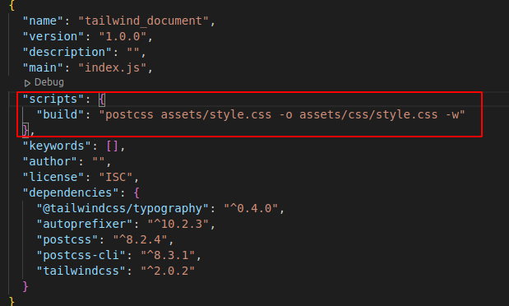
Through Terminal Tailwind compiler
Through package.json compiler

Slide 18
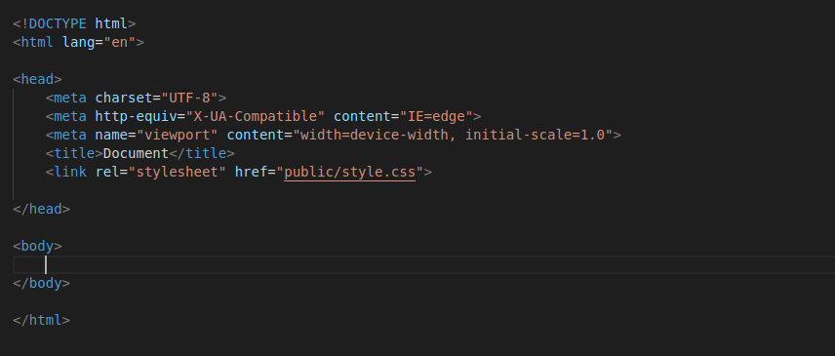
Add style in your document

Slide 19
05
Tailwind classes
Installing TailwindCSS

Slide 20
Background classes & shades
this is set of classes change the background color of an element using a scale of 100-900 for shades and a palette ofover 9 shades.
.bg-[ * ]-{100-900} {}
[ black, white, gray, red, orange,yellow, green, teal, indigo, blue,purple, pink ]
.bg-gray-400 --tw-bg-opacity: 1;
background-color: rgba(156, 163, 175, var(--tw-bg-opacity));
.bg-transparent background-color: transparent;
.bg-current background-color: currentColor;
.text-[ * ]-{100-900} {} Same as text colors

Slide 21
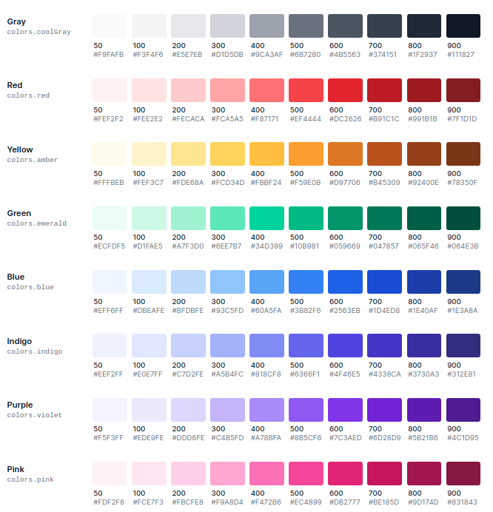
Color shade

Slide 22
Background Attachment
Class | Properties
bg-fixed | background-attachment: fixed;
bg-local | background-attachment: local;
bg-scroll | background-attachment: scroll;
Background Clip
Class | Properties
bg-clip-border | background-clip: border-box;
bg-clip-padding | background-clip: padding-box;
bg-clip-content | background-clip: content-box;
bg-clip-text | background-clip: text;

Slide 23
Background Position
Class | Properties
bg-bottom | background-position: bottom;
bg-center | background-position: center;
bg-left | background-position: left;
bg-left-bottom | background-position: left bottom;
bg-left-top | background-position: left top;
bg-right | background-position: right;
bg-right-bottom | background-position: right bottom;
bg-right-top | background-position: right top;
bg-top | background-position: top;

Slide 24
Background Size
Class | Properties
bg-auto | background-size: auto;
bg-cover | background-size: cover;
bg-contain | background-size: contain;
Background Repeat
Class | Properties
bg-repeat | background-repeat: repeat;
bg-no-repeat | background-repeat: no-repeat;
bg-repeat-x | background-repeat: repeat-x;
bg-repeat-y | background-repeat: repeat-y;
bg-repeat-round | background-repeat: round;
bg-repeat-space | background-repeat: space;

Slide 25
Background gradient
Class | Properties
bg-none | background-image: none;
bg-gradient-to-t | background-image: linear-gradient(to top, var(--tw-gradient-stops));
bg-gradient-to-tr | background-image: linear-gradient(to top right, var(--tw-gradient-stops));
bg-gradient-to-r | background-image: linear-gradient(to right, var(--tw-gradient-stops));
bg-gradient-to-br | background-image: linear-gradient(to bottom right, var(--tw-gradient-stops));
bg-gradient-to-b | background-image: linear-gradient(to bottom, var(--tw-gradient-stops));
bg-gradient-to-bl | background-image: linear-gradient(to bottom left, var(--tw-gradient-stops));
bg-gradient-to-l | background-image: linear-gradient(to left, var(--tw-gradient-stops));
bg-gradient-to-tl | background-image: linear-gradient(to top left, var(--tw-gradient-stops));

Slide 26

Gradient Color Stops
 | Start | Center | End
bg-gradient-to-r | from-transparent | via-blue-700 | to-gray-200
bg-gradient-to-br | from-gray-500 | via-gray-700 | to-red-200
bg-gradient-to-bl | from-red-100 | via-red-600 | to-blue-200
bg-gradient-to-tr | from-yellow-100 | via-yellow-400 | to-green-200

Slide 27
Tailwind's Numbering System
All of the numbers in Tailwind are based around the rem unit of measurement. 1 rem is equal to the size
of the base font of the document. As an example, if the base font size is 16px then 1 rem is equal to
16px and we can deduce that 1.25 rem is equal to 20px . To help with these fractional numbers,
Tailwind's numbered classes are multiplied by 4 to avoid having numbers with decimal places.
Assuming the base fontsize of the document is 16px
Pixels | Rem | Tailwind
0px | 0rem | 0
4px | 0.25 rem | 1
8px | 0.5rem | 2
12px | 0.75rem | 3
16px | 1rem | 4
20px | 1.25rem | 5
24px | 1.50rem | 6
28px | 1.75rem | 7
Continues to all of the available default sizes 12, 16, 20, 24, 32, 40, 48, 56, 64

Slide 28
Display
Utilities for controlling the display box type of an element.
Class | Properties
block | display: block;
inline-block | display: inline-block;
inline | display: inline;
flex | display: flex;
inline-flex | display: inline-flex;
table | display: table;
Floats
Class | Properties
float-right | float: right;
float-left | float: left;
float-none | float: none;

Slide 29
Clear
Utilities for controlling the wrapping of content around an element.
Class | Properties
clear-left | clear: left;
clear-right | clear: right;
clear-both | clear: both;
clear-none | clear: none;

Slide 30
Position
Utilities for controlling how an element is positioned in the DOM.
Class | Properties
static | position: static;
fixed | position: fixed;
absolute | position: absolute;
relative | position: relative;
sticky | position: sticky;

Slide 31
Top / Right / Bottom / Left
Utilities for controlling the placement of positioned elements.
Class | Properties
inset-0 | top: 0px; right: 0px; bottom: 0px; left: 0px;
-inset-0 | top: -0px; right: -0px; bottom: -0px; left: -0px;
inset-x-0 | left: 0px; right: 0px;
-inset-x-0 | left: -0px; right: -0px;

Slide 32
Top / Right / Bottom / Left
Utilities for controlling the placement of positioned elements.
Class | Properties
inset-y-0 | top: 0px; bottom: 0px;
-inset-y-0 | top: -0px; bottom: -0px;
top-0 right-0 buttom-0 left-0 | left: 0px; right: 0px; bottom: 0px; left: 0px;
-top-0 -right-0 -buttom-0 -left-0 | left: -0px; right: -0px; bottom: -0px; left: -0px;

Slide 33
Flex Direction
Utilities for controlling the direction of flex items.
Class | Properties
flex-row | flex-direction: row;
flex-row-reverse | flex-direction: row-reverse;
flex-col | flex-direction: column;
flex-col-reverse | flex-direction: column-reverse;
Flex Wrap
Class | Properties
flex-wrap | flex-wrap: wrap;
flex-wrap-reverse | flex-wrap: wrap-reverse;
flex-nowrap | flex-wrap: nowrap;

Slide 34
Class | Properties
justify-start | justify-content: flex-start;
justify-end | justify-content: flex-end;
justify-center | justify-content: center;
justify-between | justify-content: space-between;
justify-around | justify-content: space-around;
justify-evenly | justify-content: space-evenly;

Slide 35
Flex
Class | Properties
flex-1 | flex: 1 1 0%;
flex-auto | flex: 1 1 auto;
flex-initial | flex: 0 1 auto;
flex-none | flex: none;
flex-grow-0 | flex-grow: 0;
flex-grow | flex-grow: 1;
flex-shrink-0 | flex-shrink: 0;
flex-shrink | flex-shrink: 1;
Order
Class | Properties
order-first | order: -9999;
order-last | order: 9999;
order-none | order: 0;
order-1 | order: 1;

Slide 36
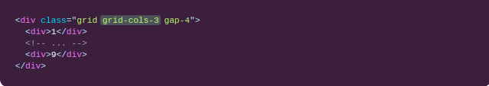

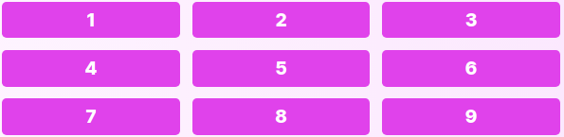
Grid Template
first, need to class grid of parent element
Use the grid-cols-{n} utilities to create grids with n equally sized columns.
n=12

Slide 37
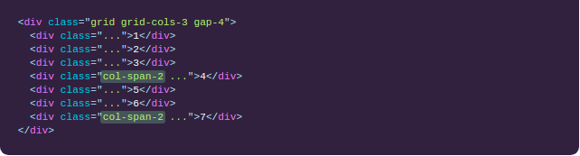
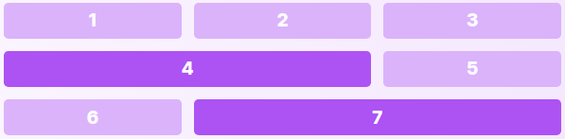
Spanning columns
Use the col-span-{n} utilities to make an element span n columns.

Slide 38
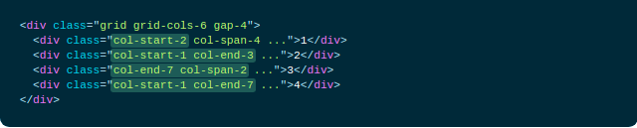
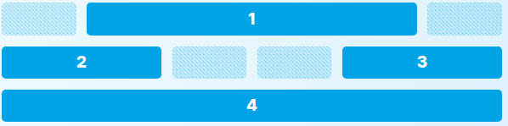
Starting and ending lines
Use the col-start-{n} and col-end-{n} utilities to make an element start or end at the nth grid line. These can also be combined with the col-span-{n} utilities to span a specific number of columns.
Note that CSS grid lines start at 1, not 0, so a full-width element in a 6-column grid would start at line 1 and end at line 7.

Slide 39

Grid Flow
Class | Properties
grid-flow-row | grid-auto-flow: row;
grid-flow-col | grid-auto-flow: column;
grid-flow-row-dense | grid-auto-flow: row dense;
grid-flow-col-dense | grid-auto-flow: column dense;

Slide 40
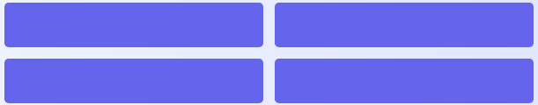
Grid Gap
Utilities for controlling gutters between grid and flexbox items.
Class | Properties
gap-0 | gap: 0px;
gap-x-0 | column-gap: 0px;
gap-y-0 | row-gap: 0px;
Use gap-{size} to change the gap between both rows and columns in grid and flexbox layouts.

Slide 41


Padding
Control the padding on one side of an element using the p{t|r|b|l|x|y}-{size} utilities.
For example, pt-6 would add 1.5rem of padding to the top of an element, pr-4 would add 1rem of padding to the right of an element, pb-8 would add 2rem of padding to the bottom of an element, and pl-2 would add 0.5rem of padding to the left of an element.

Slide 42

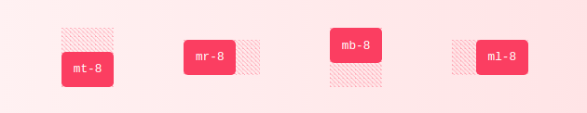
Margin
Control the margin on one side of an element using the m{t|r|b|l|x|y}-{size} utilities.
For example, mt-6 would add 1.5rem of margin to the top of an element, mr-4 would add 1rem of margin to the right of an element, mb-8 would add 2rem of margin to the bottom of an element, and ml-2 would add 0.5rem of margin to the left of an element.

Slide 43
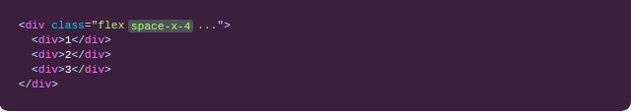
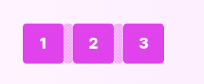
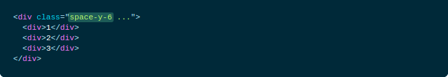
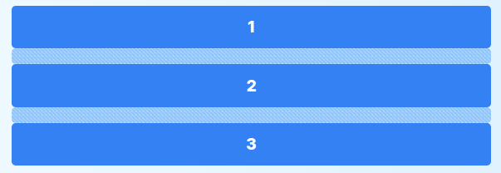
Add horizontal space between children
Control the horizontal space between elements using the space-x-{amount} utilities.
Add vertical space between children
Control the vertical space between elements using the space-y-{amount} utilities.

Slide 44
Width Height
class | Properties
w-full | width: 100%;
w-screen | width: 100vw;
w-min | width: min-content;
w-max | width: max-content;
w-1/2 | width: 50%;
w-1/3 | width: 33.333333%;
w-2/3 | width: 66.666667%;
w-1/4 | width: 25%;
w-4 | width: 1rem;
w-5 | width: 1.25rem;
w-6 | width: 1.5rem;
w-7 | width: 1.75rem;
class | Properties
h-full | height: 100%;
h-screen | height: 100vh;
h-min | height: min-content;
h-max | height: max-content;
h-1/2 | height: 50%;
h-1/3 | height: 33.333333%;
h-2/3 | height: 66.666667%;
h-1/4 | height: 25%;
h-4 | height: 1rem;
h-5 | height: 1.25rem;
h-6 | height: 1.5rem;
h-7 | height: 1.75rem;

Slide 45
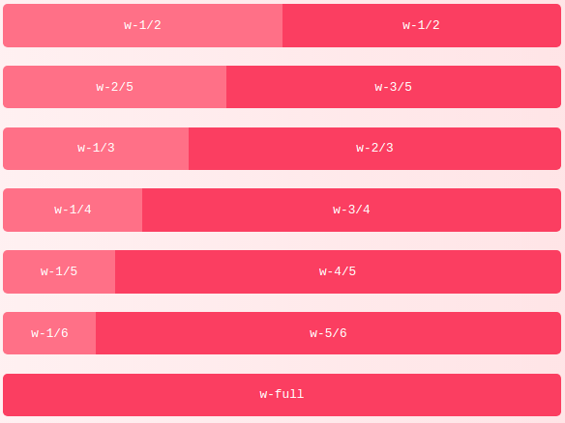

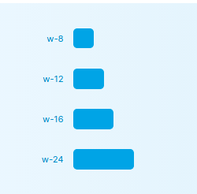
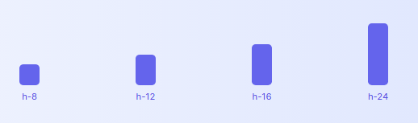

Slide 46
Font Family
Class | Properties
font-sans | font-family: ui-sans-serif, system-ui, -apple-system, BlinkMacSystemFont, "Segoe UI", Roboto, "Helvetica Neue", Arial, "Noto Sans", sans-serif, "Apple Color Emoji", "Segoe UI Emoji", "Segoe UI Symbol", "Noto Color Emoji";
font-serif | font-family: ui-serif, Georgia, Cambria, "Times New Roman", Times, serif;
font-mono | font-family: ui-monospace, SFMono-Regular, Menlo, Monaco, Consolas, "Liberation Mono", "Co

Slide 47
Font Size
Class | Properties
text-xs text-sm text-base text-lg text-xl text-2xl text-3xl // // text-9xl | .75rem; .875rem; 1rem; 1.125rem; 1.25rem; 1.5rem; 1.875rem; // // 8rem

Slide 48
Font Weight
Class | Properties
font-thin | font-weight: 100;
font-extralight | font-weight: 200;
font-light | font-weight: 300;
font-normal | font-weight: 400;
font-medium | font-weight: 500;
font-semibold | font-weight: 600;
font-bold | font-weight: 700;
font-extrabold | font-weight: 800;
font-black | font-weight: 900;

Slide 49
Letter Spacing
Class | Properties
tracking-tighter | letter-spacing: -0.05em;
tracking-tight | letter-spacing: -0.025em;
tracking-normal | letter-spacing: 0em;
tracking-wide | letter-spacing: 0.025em;
tracking-wider | letter-spacing: 0.05em;
tracking-widest | letter-spacing: 0.1em;

Slide 50
Line Height
Class | Properties
leading-none | line-height: 1;
leading-tight | line-height: 1.25;
leading-snug | line-height: 1.375;
leading-normal | line-height: 1.5;
leading-relaxed | line-height: 1.625;
leading-loose | line-height: 2;
leading-3 | line-height: .75rem;
leading-4 | line-height: 1rem;
leading-5 | line-height: 1.25rem;

Slide 51
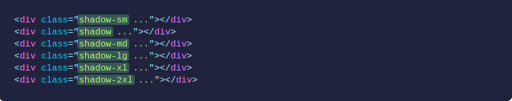
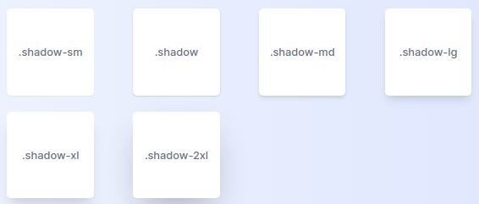
Outer shadow
Use the shadow-sm, shadow, shadow-md, shadow-lg, shadow-xl, or shadow-2xl utilities to apply different sized outer box shadows to an element.

Slide 52
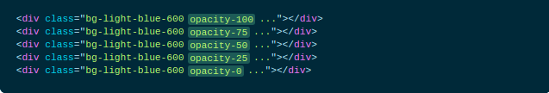

Opacity
Control the opacity of an element using the opacity-{amount} utilities.

Slide 53


Transform
To enable transformations you have to add the transform utility.
Scale
Control the scale of an element by first enabling transforms with the transform utility, then specifying the scale using the scale-{percentage}, scale-x-{percentage}, and scale-y-{percentage} utilities.
75=0.75 100=1
125=1.25
150=1.5

Slide 54


Rotate
Rotate an element by first enabling transforms with the transform utility, then specifying the rotation angle using the rotate-{angle} utilities.
for negative value use -rotate-{angle}

Slide 55


Translate
Translate an element by first enabling transforms with the transform utility, then specifying the translate direction and distance using the translate-x-{amount} and translate-y-{amount} utilities.
-translate-x-1/2 --tw-translate-x: -50%;
-translate-x-1/3 --tw-translate-x: -33.333333%;

Slide 56


Skew
Skew an element by first enabling transforms with the transform utility, then specifying the skew angle using the skew-x-{amount} and skew-y-{amount} utilities.

Slide 57
Transform Origin
Class | Properties
origin-center | transform-origin: center;
origin-top | transform-origin: top;
origin-top-right | transform-origin: top right;
origin-right | transform-origin: right;
origin-bottom-right | transform-origin: bottom right;
origin-bottom | transform-origin: bottom;
origin-bottom-left | transform-origin: bottom left;
origin-left | transform-origin: left;
origin-top-left | transform-origin: top left;

Slide 58


Specify an element’s transform origin using the origin-{keyword} utilities.

Slide 59
Transition Property
Use the transition-{properties} utilities to specify which properties should transition when they change.
properties{ none, all, colors, opacity, shadow, transform }
transition-timing-function: cubic-bezier(0.4, 0, 0.2, 1);
transition-duration: 150ms;

Slide 60
Transition Duration
Class | Properties
duration-75 | transition-duration: 75ms;
duration-100 | transition-duration: 100ms;
duration-150 | transition-duration: 150ms;
duration-200 | transition-duration: 200ms;
duration-300 | transition-duration: 300ms;
duration-500 | transition-duration: 500ms;
duration-700 | transition-duration: 700ms;
duration-1000 | transition-duration: 1000ms;

Slide 61
Transition Timing Function
Use the ease-{timing} utilities to control an element’s easing curve.
Class | Properties
ease-linear | transition-timing-function: linear;
ease-in | transition-timing-function: cubic-bezier(0.4, 0, 1, 1);
ease-out | transition-timing-function: cubic-bezier(0, 0, 0.2, 1);
ease-in-out | transition-timing-function: cubic-bezier(0.4, 0, 0.2, 1);

Slide 62
Transition Delay
Use the delay-{amount} utilities to control an element’s transition-delay.
Class | Properties
delay-75 | transition-delay: 75ms;
delay-100 | transition-delay: 100ms;
delay-150 | transition-delay: 150ms;
delay-200 | transition-delay: 200ms;
delay-300 | transition-delay: 300ms;
delay-500 | transition-delay: 500ms;
delay-700 | transition-delay: 700ms;
delay-1000 | transition-delay: 1000m

Slide 63
Animation
Class | Properties
animate-spin | animation: spin 1s linear infinite; @keyframes spin { from { transform: rotate(0deg); } to { transform: rotate(360deg); } }
animate-ping | animation: ping 1s cubic-bezier(0, 0, 0.2, 1) infinite; @keyframes ping { 75%, 100% { transform: scale(2); opacity: 0; } }

Slide 64
Class | Properties
animate-pulse | animation: pulse 2s cubic-bezier(0.4, 0, 0.6, 1) infinite; @keyframes pulse { 0%, 100% { opacity: 1; } 50% { opacity: .5; } }
animate-bounce | animation: bounce 1s infinite; @keyframes bounce { 0%, 100% { transform: translateY(-25%); animation-timing-function: cubic-bezier(0.8, 0, 1, 1); } 50% { transform: translateY(0); animation-timing-function: cubic-bezier(0, 0, 0.2, 1); } }}

Slide 65

SVG
Use fill-current to set the fill color of an SVG to the current text color. This makes it easy to set an element’s fill color by combining this class with an existing text color utility.
By default, only responsive variants are generated for fill utilities.

Slide 66

Stroke
Use stroke-current to set the stroke color of an SVG to the current text color. This makes it easy to set an element’s stroke color by combining this class with an existing text color utility.

Slide 67


Stroke Width
Class | Properties
stroke-0 | stroke-width: 0;
stroke-1 | stroke-width: 1;
stroke-2 | stroke-width: 2;
Use the stroke-{width} utilities to set the stroke width of an SVG.

Slide 68

Hover
By default, the hover variant is enabled for the following core plugins:
backgroundColor
backgroundOpacity
borderColor
borderOpacity
boxShadow
gradientColorStops
opacity
rotate
scale
skew
textColor
textDecoration
textOpacity
translate

Slide 69
Focus
By default, the focus variant is enabled for the following core plugins:
accessibility
backgroundColor
backgroundOpacity
borderColor
borderOpacity
boxShadow
gradientColorStops
opacity
outline
placeholderColor
placeholderOpacity
ringColor
ringOffsetColor
ringOffsetWidth
ringOpacity
ringWidth
rotate
scale
skew
textColor
textDecoration
textOpacity
translate
zIndex

Slide 70

Active
Add the active: prefix to only apply a utility when an element is active.
By default, the active variant is not enabled for any core plugins.
You can control whether active variants are enabled for a plugin in the variants section of your tailwind.config.js file:

Slide 71

Group-hover
If you need to style a child element when hovering over a specific parent element, add the group class to the parent element and add the group-hover: prefix to the utility on the child element.
By default, the group-hover variant is enabled for the following core plugins:
backgroundColor
backgroundOpacity
borderColor
borderOpacity
boxShadow
opacity
textColor
textDecoration
textOpacity

Slide 72
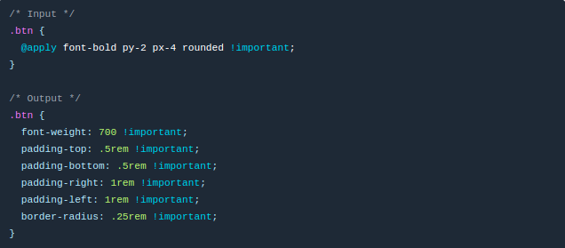
@apply
Use @apply to inline any existing utility classes into your own custom CSS.

Slide 73
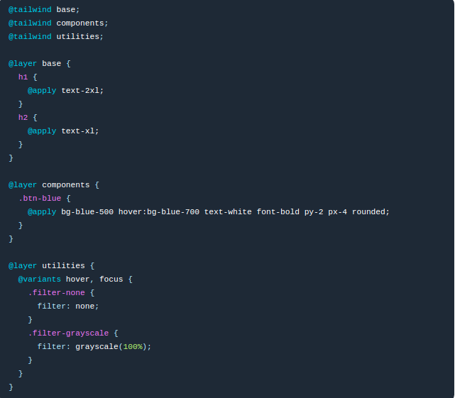
@layer
Use the @layer directive to tell Tailwind which “bucket” a set of custom styles belong to. Valid layers are a base, components, and utilities.

Slide 74
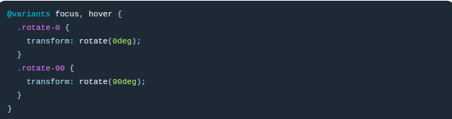
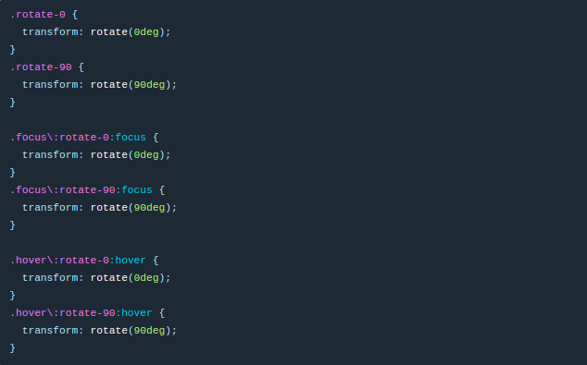
@variants
You can generate responsive, hover, focus, active, and other variants of your own utilities by wrapping their definitions in the @variants directive.

Slide 75

Responsive Design
Breakpoint prefix | Minimum width | CSS
sm | 640px | @media (min-width: 640px) { ... }
md | 768px | @media (min-width: 768px) { ... }
lg | 1024px | @media (min-width: 1024px) { ... }
xl | 1280px | @media (min-width: 1280px) { ... }
2xl | 1536px | @media (min-width: 1536px) { ... }

Slide 76
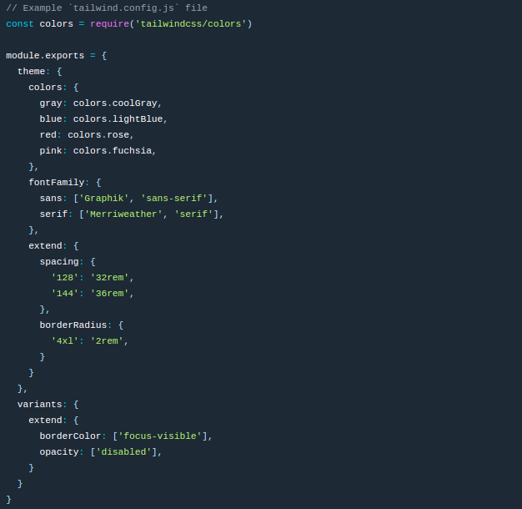
Customization

Slide 77
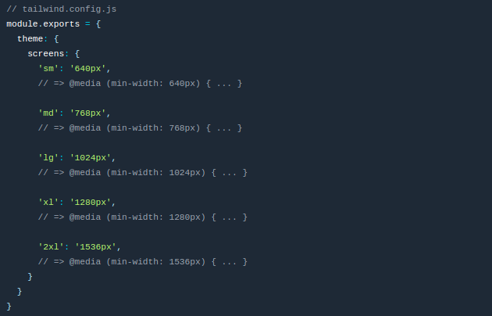
Breakpoints

Slide 78
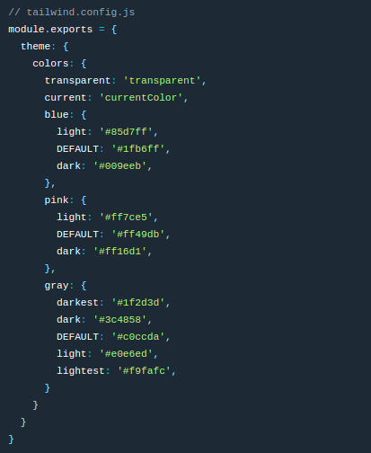
Customizing Colors

Slide 79
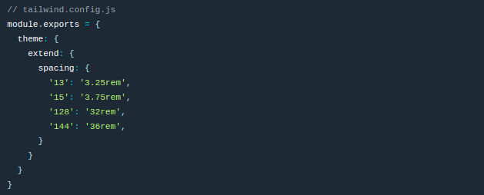
spacing scale

Slide 80
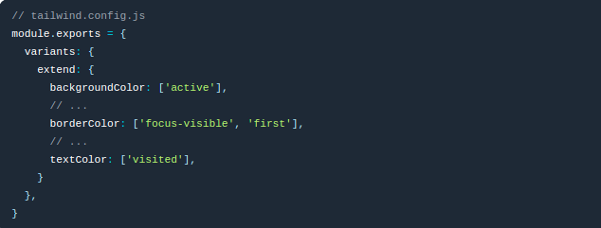
Configuring Variants

Slide 81
THANK YOU

Slide 82
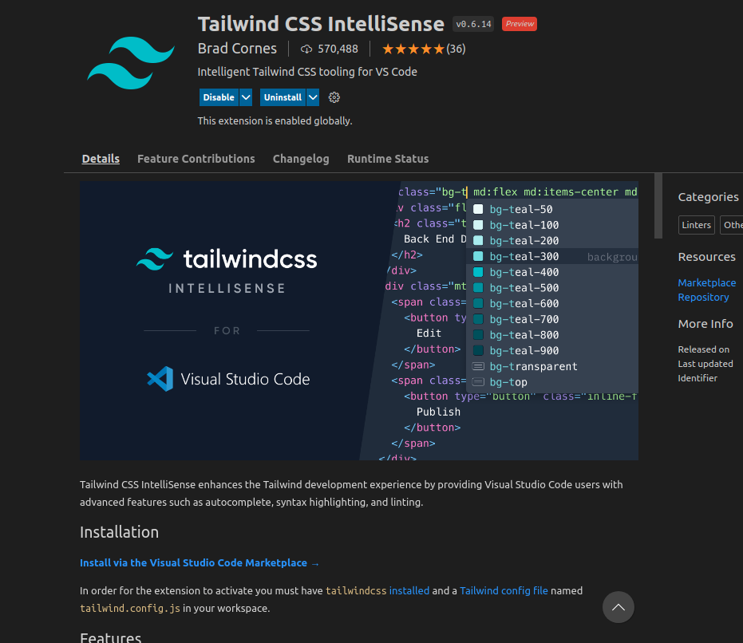
extension

